Slide 1
Wearable Cameras for Stroke Survivors
Nathaniel Marshall Jacob Martin Michael Devenish Andrew Grant

Slide 2
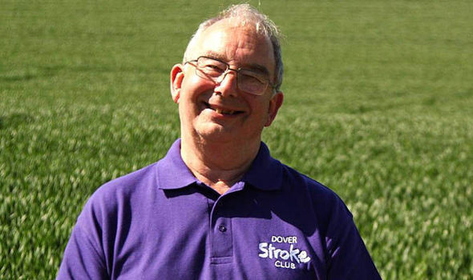
Problem Definition and Solution
Use of wearable cameras to aid stroke survivors
Use of machine learning to identify actions
Desktop application to show activity

Slide 3
Project Scope and Feasibility
Build a desktop application which is capable of image processing
Uses deep learning techniques to detect human arm and hand movement
Scope of the project is limited to healthy test subjects

Slide 4
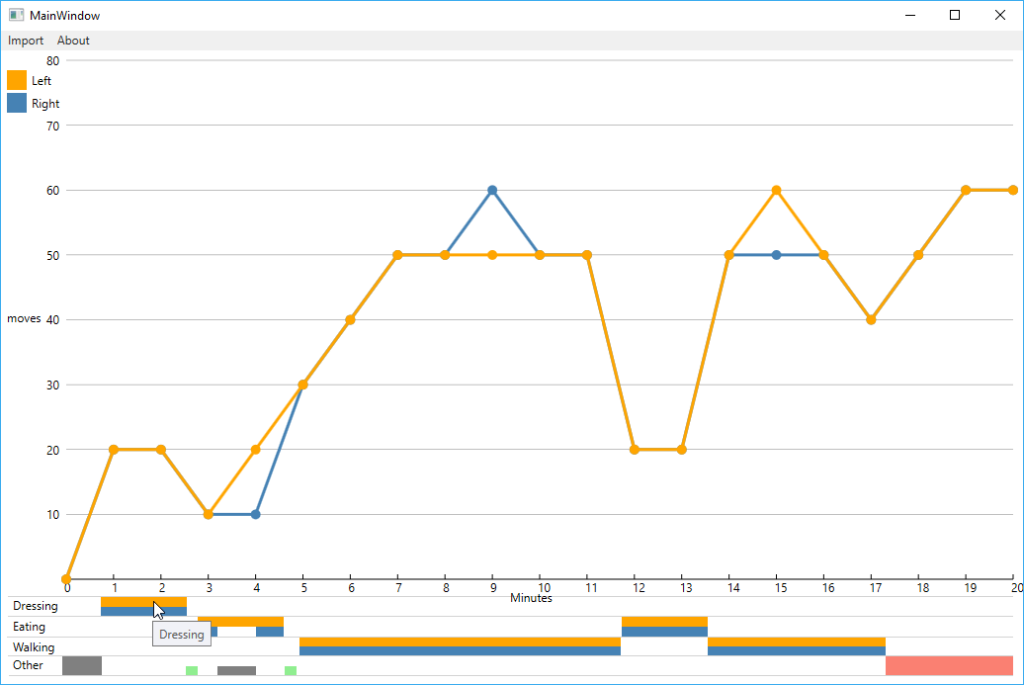
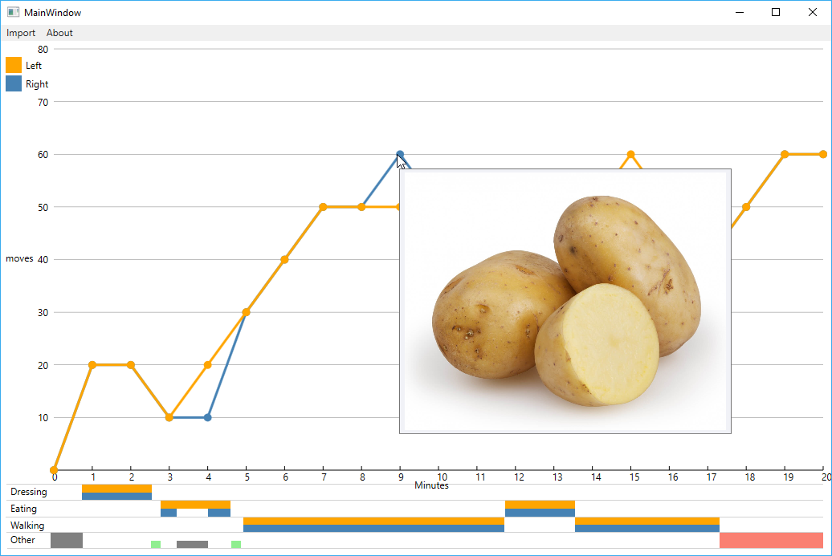
Soundness of Design

Slide 5
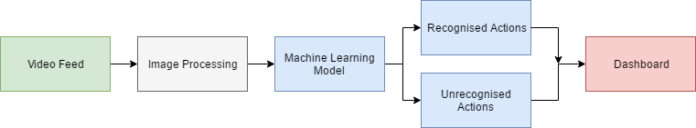
Soundness of Design
Video Feed: Received from camera or phone
Image Processing: Lowers resolution and framerate reducing he amount of data needed to be processed
Machine Learning: Identify learnt actions and unrecognized actions
Dashboard: the application used to view the results

Slide 6
Initial Work and Prototype
Performed a literature review into machine learning and video analysis
Performed a camera evaluation on the different choices available in the market
Made a desktop application mockup
Researched basic required knowledge for the project

